Slide 1
CS 211 Computer Architecture Lecture 17: RISC-V Architecture – C Memory Layout, Runtime Stack, Function Calls
Ravi Mittal
ravi.mittal@iitgoa.ac.in
Indian Institute of Technology, Goa

Slide 2
Acknowledgements
Digital Design and Computer Architecture: RISC-V Edition, Harris & Harris Elsevier – Presentation.
Class Presentation, CS61C, Introduction to Assembly Language and RISC-V Instruction Set Architecture, University of Berkeley, Prof Krste Asanović & Randy H. Katz. http://inst.eecs.Berkeley.edu/~cs61c
Computer Organization and Design, The Hardware Software Interface, RISC-V edition, Patterson and Hennessey

Slide 3
In today’s class we will study
C Memory Map – Runtime
RISC-V – The Stack - Details
Register Saving Convention
Function Calls: Non-leaf and leaf

Slide 4
Previous Classes

Slide 5
So far we have studied
Arithmetic operations: add, sub, addi,
How to bring data from memory to register and vice versa?
lw, sw, lb, sb, lbu
Bit-by-bit logical instructions
and, or, xor
andi, ori, xori
Logical Shift instructions
sll, srl, sra
slli, srli, srai
Generating Constants
Branching Instructions: beq, bne, blt/bltu, bge/bgeu
Jumping instruction: j
Assembly level program for: if, if/else, while, for loops
Function calls

Slide 6
C Memory Map - Runtime

Slide 7
C Memory Layout
Program’s address space contains 4 regions:
Stack: local variables, grows downward
Heap: space requested via malloc() and used with pointers; resizes dynamically, grows upward
Static Data: global and static variables, does not grow or shrink
Code: loaded when program starts, does not change
~ FFFF FFFF_{hex}
stack
heap
static data
code
~ 0_{hex}
OS prevents accesses between stack and heap
(via virtual memory)
Ref: Lecture slides CS61C, University of California at Berkeley

Slide 8
Where Do the Variables Go?
Declared outside a function:
Static Data
Declared inside a function:
Stack
main() is a function
Freed when function returns
Dynamically allocated:
Heap
i.e. malloc
#include <stdio.h>
int varGlobal;
int main() {
int varLocal;
int *varDyn = malloc(sizeof(int));
}
Ref: Lecture slides CS61C, University of California at Berkeley

Slide 9
The Stack
Function call:
Each stack frame is a contiguous block of memory holding the local variables of a single procedure
A stack frame includes:
Location of caller function
Function arguments
Space for local variables
Stack pointer (SP) tells where lowest (current) stack frame is
When procedure ends, stack pointer is moved back (but data remains (garbage!)); frees memory for future stack frames;
frame
frame
SP
frame
frame
SP
…
Ref: Lecture slides CS61C, University of California at Berkeley

Slide 10
The Stack
stack
Last In, First Out (LIFO) data structure
int main() {
a(0);
return 1; }
void a(int m) {
b(1); }
void b(int n) {
c(2);
d(4); }
void c(int o) {
printf(“c”); }
void d(int p) {
printf(“d”); }
Stack grows down
Stack Pointer
Stack Pointer
Stack Pointer
Stack Pointer

Slide 11
The Stack Frame – Another view
main stack frame
int main(…) {
...
myfn(x);
}
int myfn(int n) {
...
myfn();
}
myfn stack frame
system reserved
fp→
myfn stack frame
stack
sp→
heap
Static/global data
code
system reserved

Slide 12
Stack Misuse Example (self study)
Never return pointers to
local variable from functions
Your compiler will warn you about this
– don’t ignore such warnings!
int *getPtr() { int y; y = 3; return &y; };
int main () { int *stackAddr,content; stackAddr = getPtr(); content = *stackAddr; printf("%d", content); /* 3 */ content = *stackAddr; printf("%d", content); /* ? */
};
main
main
main
What’s BAD about
this function?
SP
getPtr() (y==3)
printf() (y==?)
stackAddr
SP
SP
printf
overwrites
stack frame
Notes:
Maybe delete the /* 0 */

Slide 13
C Memory Layout
Program’s address space contains 4 regions:
Stack: local variables, grows downward
Heap: space requested via malloc() and used with pointers; resizes dynamically, grows upward
Static Data: global and static variables, does not grow or shrink
Code: loaded when program starts, does not change
~ FFFF FFFF_{hex}
stack
heap
static data
code
~ 0_{hex}
OS prevents accesses between stack and heap
(via virtual memory)
Ref: Lecture slides CS61C, University of California at Berkeley

Slide 14
Static Data and Code
Static Data: Place for variables that persist
Data not subject to comings and goings like function calls
Examples: String literals, global variables
String literal example: char * str = “hi”;
Size does not change, but sometimes data can
Notably string literals cannot
Code:
Copy of your code goes here
Code becomes data too!
Does not change
Notes:
Give example of string literal declaration

Slide 15
Dynamic Memory Allocation
Want persisting memory (like static) even when we don’t know size at compile time?
e.g. input files, user interaction
Stack won’t work because stack frames aren’t persistent
Dynamically allocated memory goes on the Heap – more permanent than Stack
Need as much space as possible without interfering with Stack
Start at opposite end and grow towards Stack

Slide 16
RISC-V - The Stack Details
Ref: Harris and Harris Book: Digital Design and Computer Architecture: RISC-V Edition

Slide 17
RISC-V Symbolic Register Names
Name | Register Number | Usage
zero | x0 | Constant value 0
ra | x1 | Return address
sp | x2 | Stack pointer
gp | x3 | Global pointer
tp | x4 | Thread pointer
t0-2 | x5-7 | Temporaries
s0/fp | x8 | Saved register / Frame pointer
s1 | x9 | Saved register
a0-1 | x10-11 | Function arguments / return values
a2-7 | x12-17 | Function arguments
s2-11 | x18-27 | Saved registers
t3-6 | x28-31 | Temporaries
Numbers hardware understands
Human-friendly symbolic names in assembly code
Ref: Harris and Harris Book: Digital Design and Computer Architecture: RISC-V Edition

Slide 18
Stack Basics (revision)
A place to save old values before call function, restore them when return, and delete
Two operations:
Push - place data into the stack
Pop - remove data from the stack
Stack is in memory so we need a register to point to it
Stack Pointer (sp): Points to the top of the stack
Stacks “grow” from higher addresses to lower addresses
Push decrements sp and Pop increments sp
One of the important function of stack is to save and restore registers that are used by a function

Slide 19

The Stack - Basics
Grows down (from higher to lower memory addresses)
Stack pointer: sp points to top of the stack
Note that sp is a register x2
Ref: Harris and Harris Book: Digital Design and Computer Architecture: RISC-V Edition

Slide 20
Which registers can we use?
Problem: how does the function know which registers are safe to use?
Function A may have been using t0 when it called Function B!
Function A
Function B
Ref: Lecture slides CS61C, University of California at Berkeley

Slide 21
How Functions use a stack?
Called functions must have no unintended side effects
But diffofsums overwrites 3 registers: t0, t1, s3
# RISC-V assembly
# s3 = result
diffofsums:
add t0, a0, a1 # t0 = f + g
add t1, a2, a3 # t1 = h + i
sub s3, t0, t1 # result = (f + g) − (h + i)
add a0, s3, zero # put return value in a0
jr ra # return to caller
Ref: Harris and Harris Book: Digital Design and Computer Architecture: RISC-V Edition

Slide 22
Storing Register Values on the Stack
# s3 = result
diffofsums:
addi sp, sp, -12 # make space on stack to
# store three registers
sw s3, 8(sp) # save s3 on stack
sw t0, 4(sp) # save t0 on stack
sw t1, 0(sp) # save t1 on stack
add t0, a0, a1 # t0 = f + g
add t1, a2, a3 # t1 = h + i
sub s3, t0, t1 # result = (f + g) − (h + i)
add a0, s3, zero # put return value in a0
lw t1, 0(sp) # restore $t1 from stack
lw t0, 4(sp) # restore $t0 from stack
lw s3, 8(sp) # restore $s3 from stack
addi sp, sp, 12 # deallocate stack space
jr ra # return to caller
Ref: Harris and Harris Book: Digital Design and Computer Architecture: RISC-V Edition

Slide 23
The Stack During diffofsums Call
Before call
During call
After call
Ref: Harris and Harris Book: Digital Design and Computer Architecture: RISC-V Edition

Slide 24
Register Saving Conventions

Slide 25
Register Saving Conventions
The stack space that a function allocates for itself is called its stack frame
diffofsums’s stack frame is three words deep
Each function should access only its own stack frame, not the frames belonging to other functions
In the program, we assumed that temporary registers t0 and t1 must be saved and restored
If the calling function does not use those registers, the effort to save and restore them is wasted
To avoid this waste, RISC-V divides 19 registers into preserved and non-preserved categories
Ref: Harris and Harris Book: Digital Design and Computer Architecture: RISC-V Edition

Slide 26
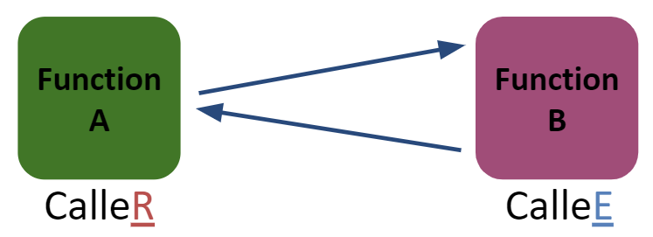
Saved Registers (Callee Saved)
These registers are expected to be the same before and after a function call
If callee uses them, it must restore values before returning
This means save the old values, use the registers, then reload the old values back into the registers
s0-s11 (saved registers)
sp (stack pointer)
If not in same place, the caller won’t be able to properly access its own stack variables
Ref: Lecture slides CS61C, University of California at Berkeley

Slide 27
Non-Preserved or Volatile Registers (Caller Saved)
These registers can be freely changed by the callee
If caller needs them, it must save those values before making a procedure call
t0-t6 (temporary registers)
a0-a7 (return address and arguments)
ra (return address)
These will change if callee invokes another function (nested function means callee is also a caller)
Ref: Lecture slides CS61C, University of California at Berkeley

Slide 28
Register Saving Conventions
Preserved Callee-Saved | Non-preserved Callee not-Saved/Caller saved if required
s0-s11 | t0-t6
sp | ra
stack above sp | a0-a7
 | stack below sp
Any (saved) Register of s0-s11 are preserved, i.e callee saves and restores them – if it uses them
Temporary Registers (t0-t6) are not saved by callee on a function call
Calller saves these registers if it wants to preserve them. Callee can use these freely
Ref: Harris and Harris Book: Digital Design and Computer Architecture: RISC-V Edition

Slide 29
Storing Saved Registers on the Stack
# s3 = result
diffofsums:
addi sp, sp, -4 # make space on stack to
# store one register
sw s3, 0(sp) # save s3 on stack
add t0, a0, a1 # t0 = f + g
add t1, a2, a3 # t1 = h + i
sub s3, t0, t1 # result = (f + g) − (h + i)
add a0, s3, zero # put return value in a0
lw s3, 0(sp) # restore $s3 from stack
addi sp, sp, 4 # deallocate stack space
jr ra # return to caller
Ref: Harris and Harris Book: Digital Design and Computer Architecture: RISC-V Edition

Slide 30
Optimized diffofsums
Note that function diffofsums need not save t0, t1 as these are temporary registers (and caller may take care of these if it is using them)
Also, s3 is a saved register – which must be saved provided diffofsums is using it. Since diffofsums is not using s3, the callee is not required to be saved and restored
# a0 = result
diffofsums:
add t0, a0, a1 # t0 = f + g
add t1, a2, a3 # t1 = h + i
sub a0, t0, t1 # result = (f + g) − (h + i)
jr ra # return to caller
Ref: Harris and Harris Book: Digital Design and Computer Architecture: RISC-V Edition

Slide 31
Function Calls – Leaf and non-leaf

Slide 32
How do we save registers? The stack!
Address
∞
stack
local variables and saved registers
Dynamically allocated space
Global variables, string literals
Program instructions
sp
heap
static data
code
0

Slide 33
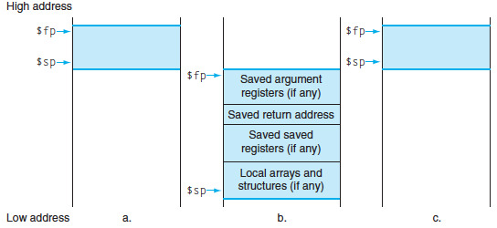
Stack Before, During, After Call
Before
During
After
Notes:
Exact ordering of saved registers is up to you (make sure you keep track, though!).
(actually don’t need to save argument registers)

Slide 34
Basic Structure of a Function
func_label: addi sp,sp, -framesize sw ra, <framesize-4>(sp)
#store other callee saved registers #save other regs if need be
#restore other regs if need be #restore other callee saved registers
lw ra, <framesize-4>(sp)
addi sp,sp, framesize jr ra
Prologue
Body (call other functions…)
...
Epilogue
Notes:
Substitute the proper immediate for <framesize-4>.
Can order registers on stack however you want to, but must make sure to restore them properly.

Slide 35
Example function with calling convention
Leaf:
addi sp,sp,-8 # allocate stack
sw s1,4(sp) # save s1
sw s0,0(sp) # save s0
add s0,a0,a1 # s0 = g+h
add s1,a2,a3 # s1 = i+j
sub a0,s0,s1 # return value
# = s0-s1
lw s0,0(sp) # restore s0
lw s1,4(sp) # restore s1
addi sp,sp,8 # free stack
jr ra # return
int Leaf(int g, int h,
int i,
int j){
int f;
f = (g+h)-(i+j);
return f;
}

Slide 36
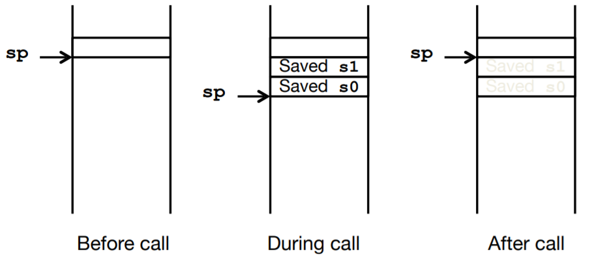
Stack during function execution
Need to save old values of s0 and s1

Slide 37
Different register choices could reduce effort
Leaf:
# nothing to save on stack
add t0,a0,a1 # t0 = g+h
add t1,a2,a3 # t1 = i+j
sub a0,t0,t1 # return value
# = t0-t1
# nothing to restore from stack
jr ra # return
int Leaf(int g, int h,
int i,
int j){
int f;
f = (g+h)-(i+j);
return f;
}
Be lazy! Use register choices that minimize saving to the stack.
It makes your program faster too...

Slide 38
Non leaf Functions

Slide 39
Non-Leaf Function Calls
Non-leaf function: a function that calls another function
Non-leaf functions are complicated
caller may need to save non-preserved registers on the stack before they call another function and then restore those registers afterward
Callee needs to preserve and restore any preserved registers that it intends to use

Slide 40
Non Leaf Function Calls
func1:
addi sp, sp, -4 # make space on stack
sw ra, 0(sp) # save ra on stack
jal func2
...
lw ra, 0(sp) # restore ra from stack
addi sp, sp, 4 # deallocate stack space
jr ra # return to caller
We also need to preserve sp before jumping to a non-leaf procedure
Ref: Harris and Harris Book: Digital Design and Computer Architecture: RISC-V Edition

Slide 41
Function Call Summary
Caller
Put arguments in a0-a7
Save any needed registers (ra, t0-t6 if needed later) into the stack
Call function: jal callee
On return from called function, restore registers
Look for result in a0
Callee
Save saved-registers that might be used (s0-s11) – into the stack
Perform function
Put result in a0
Restore saved-registers (s0-s11)
Return: jr ra
Ref: Harris and Harris Book: Digital Design and Computer Architecture: RISC-V Edition

Slide 42
Recursive Function

Slide 43
Recursive Functions
A recursive function is a non-leaf function that calls itself
Many programs are easier to write recursively
Any recursive function can also be written iteratively
Similarly any iterative function can also be written recursively
int factorial(int n) {
if (n <= 1)
return 1;
else
return (n * factorial(n − 1));
}
Ref: Harris and Harris Book: Digital Design and Computer Architecture: RISC-V Edition

Slide 44
Recursive Function
0x8500 factorial: addi sp, sp, -8 # make room for a0, ra
0x8504 sw a0, 4(sp)
0x8508 sw ra, 0(sp)
0x850C addi t0, zero, 1 # temporary = 1
0x8510 bgt a0, t0, else # if n>1, go to else
0x8514 addi a0, zero, 1 # otherwise, return 1
0x8518 addi sp, sp, 8 # restore sp
0x851C jr ra # return
0x8520 else: addi a0, a0, -1 # n = n − 1
0x8524 jal factorial # recursive call
0x8528 lw ra, 0(sp) # restore ra
0x852C lw t1, 4(sp) # restore n into t1
0x8530 addi sp, sp, 8 # restore sp
0x8534 mul a0, t1, a0 # a0 = n*factorial(n−1)
0x8538 jr ra # return
Ref: Harris and Harris Book: Digital Design and Computer Architecture: RISC-V Edition

Slide 45
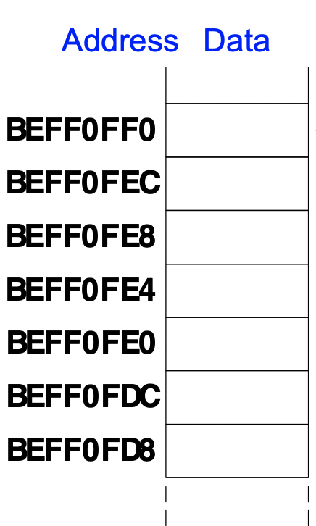
Recursive Function
0x8500 factorial: addi sp, sp, -8
0x8504 sw a0, 4(sp)
0x8508 sw ra, 0(sp)
0x850C addi t0, zero, 1
0x8510 bgt a0, t0, else
0x8514 addi a0, zero, 1
0x8518 addi sp, sp, 8
0x851C jr ra
0x8520 else: addi a0, a0, -1
0x8524 jal factorial
0x8528 lw ra, 0(sp)
0x852C lw t1, 4(sp)
0x8530 addi sp, sp, 8
0x8534 mul a0, t1, a0
0x8538 jr ra
Ref: Harris and Harris Book: Digital Design and Computer Architecture: RISC-V Edition

Slide 46
Recursive Function
Stack (a) before, (b) during, and (c) after recursive call.
Ref: Harris and Harris Book: Digital Design and Computer Architecture: RISC-V Edition

Slide 47
Class Summary
The Stack – Basics
How Functions use a stack?
Register Saving conventions
Storing Saved Register on the Stack
Use of stack in Non leaf Function Calls
Recursive Functions

